Slide 1
SHWN_HJBT (BNSF LOGISTICS)
Always key the following, visible in the invoice separator sheet:
Batch ID (68) BAT ID (69) Value/No
Client Code (68) CL CODE (69) SHWN
Scac Code (68) SCAC CODE (69) HJBT

Slide 2
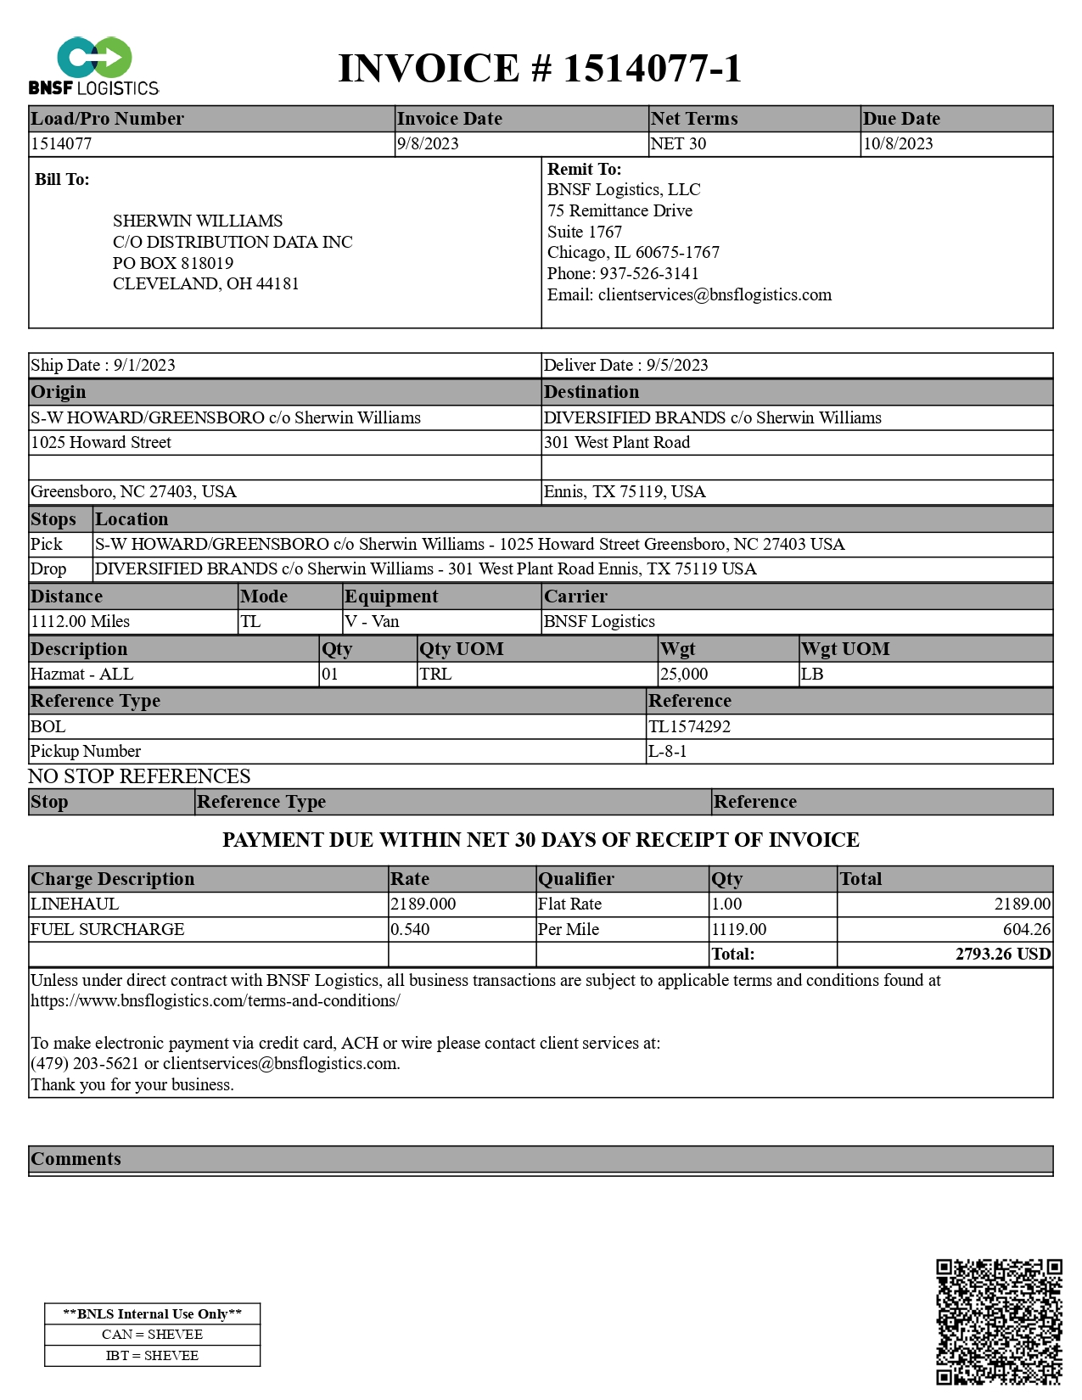
03
10
11
02
01
01 REMIT TO
02 BILL TO
03 INV KEY
09 CURR
10 DATE
11 DUE
27 SHIPPER INV
27.9 SHIPPER INV PORT
30 CONSIGNEE INV
30.9 CONSIGNEE INV PORT
38 SRVC LEVEL
42/43 ACTUAL/FNCL WT
44/45 UOM
46 PIECES
47 TYPE
48 DISTANCE
49 UOM
61 PICKUP
62 DELIVERED
68a VEHICLE TYPE
68b BOL
72 LINE ITEM DESCRIPTION
74 LINE ITEM QTY Q
75 LINE ITEM RATE
77 LINE ITEM RTUNT
85 LINE ITEM AMOUNT
90 PROD DESC
08/14 INV AMT/FB AMT
61
62
27
30
27.9
49
30.9
48
68a
42/43
44/45
90
38
68b
46
47
75
77
74
72
85
08/14
09

Slide 3
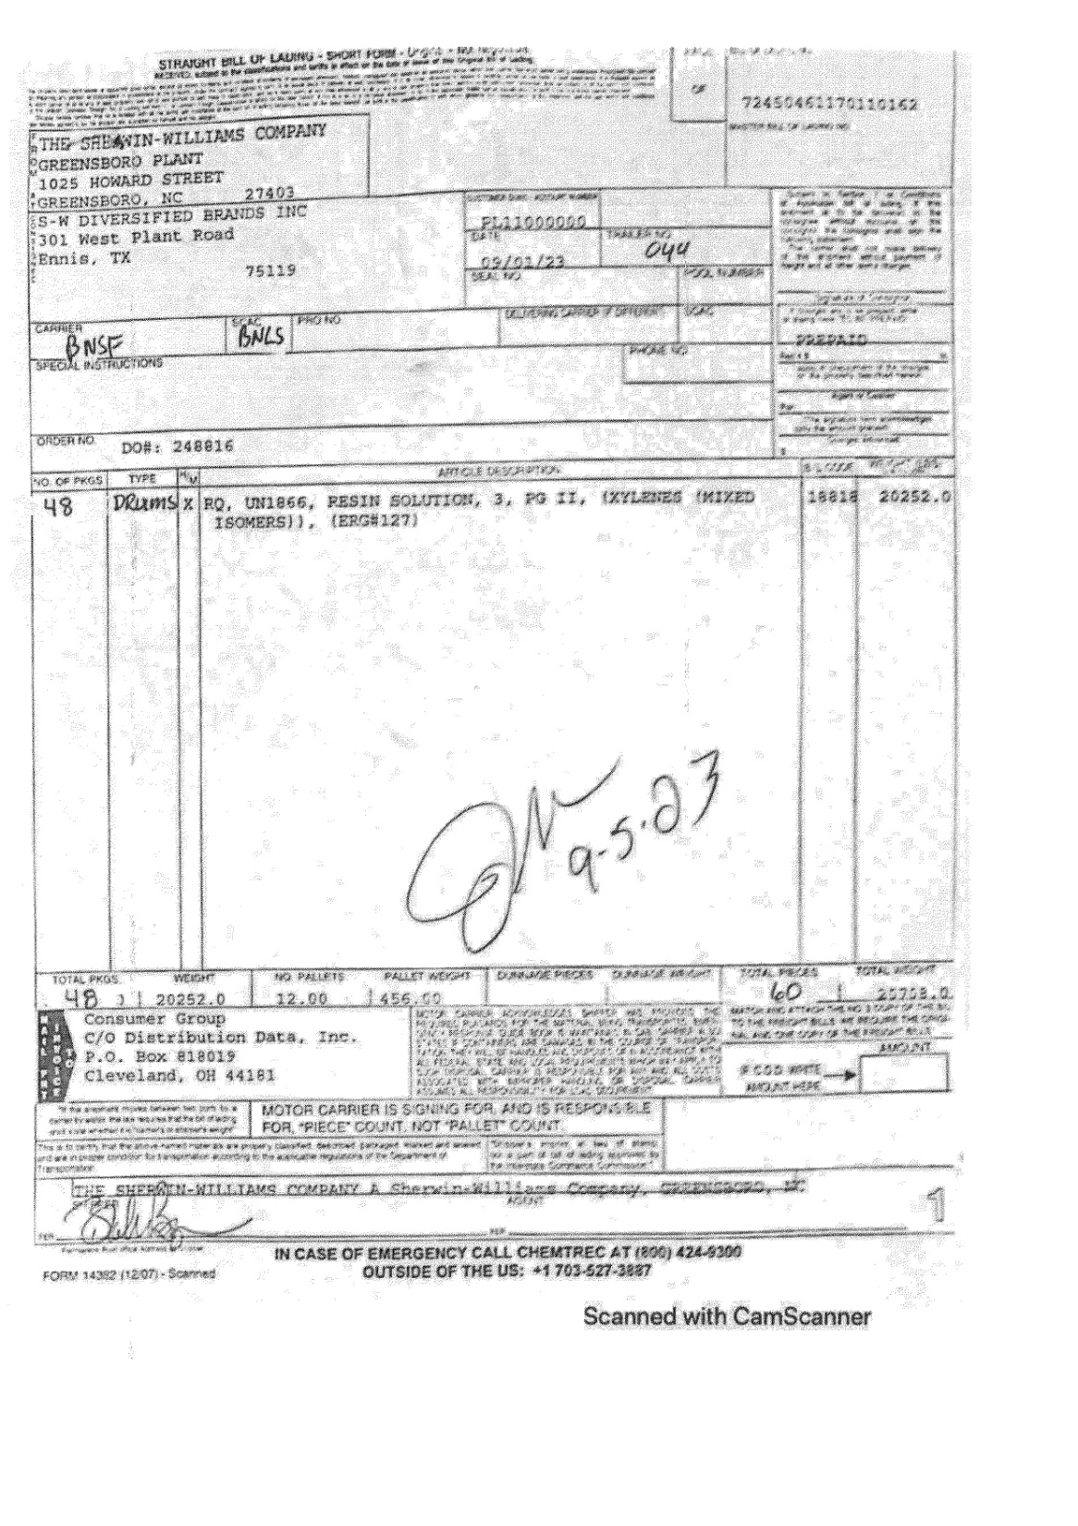
68a
28
31
61
68b
36
28 SHIPPER BOL
31 CONSIGNEE BOL
36 FREIGHT TERMS
61 SHIP DATE
68a BOL
68b TRAILER NO
68c ORD
89 PROD TYPE
90 PROD DESC
95 PCS CNT
96/97 GROSS WT/NET WT
98 WT UOM
68c
98
89
90
96/97
95

Slide 4
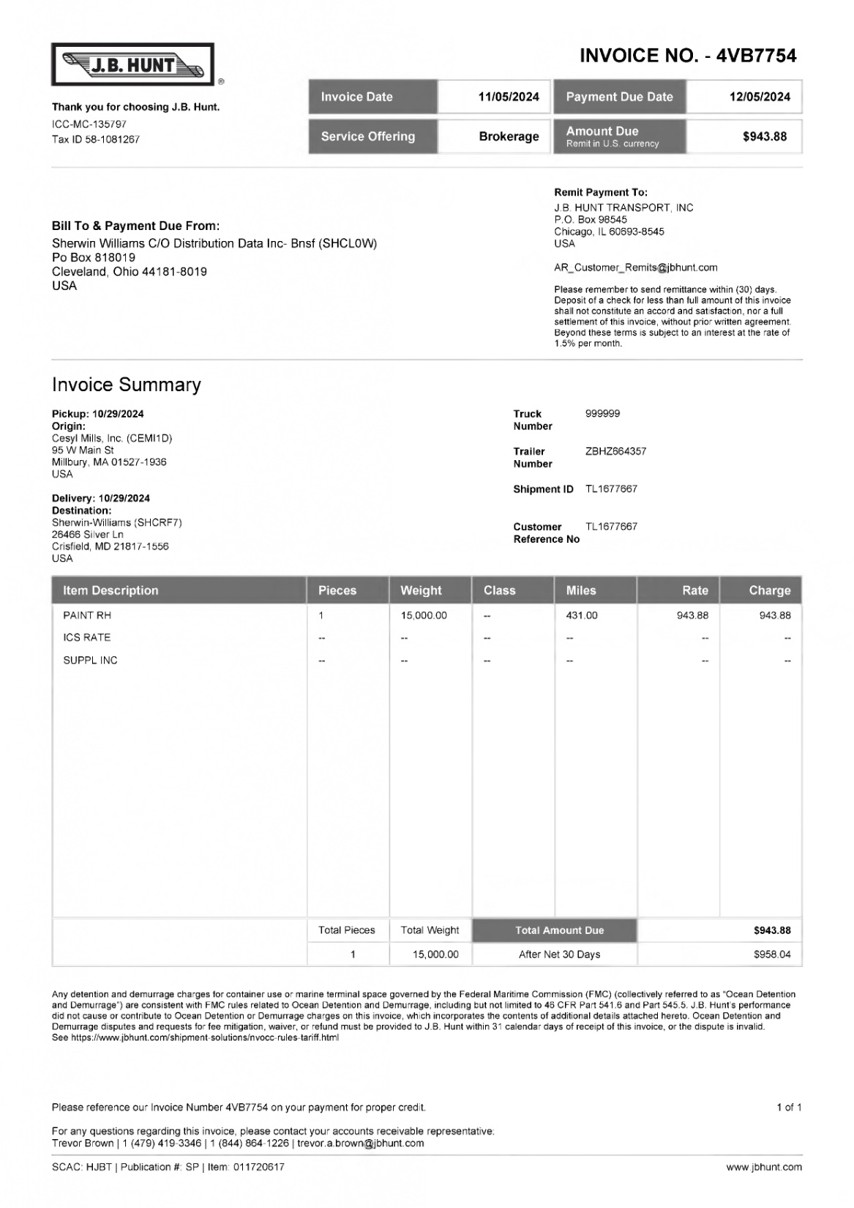
10
03
11
02
01
01 REMIT TO
02 BILL TO
03 INV KEY
10 DATE
11 DUE
27 SHIPPER INV
30 CONSIGNEE INV
42/43 ACTUAL WT/FNCL WT 48 DISTANCE
46 PIECES
61 PICK UP
62 DELIVERED
72 LINE ITEM AMT
74 QTY Q
75 LINE ITEM RATE
85 LINE ITEM AMT
68a TRAILER NO
68b SHIP NO
68c REF
08/14 INV AMT/ FB AMT
61
27
68a
62
68b
30
74
68c
72
85
48
75
08/14
46
42/43

Slide 5
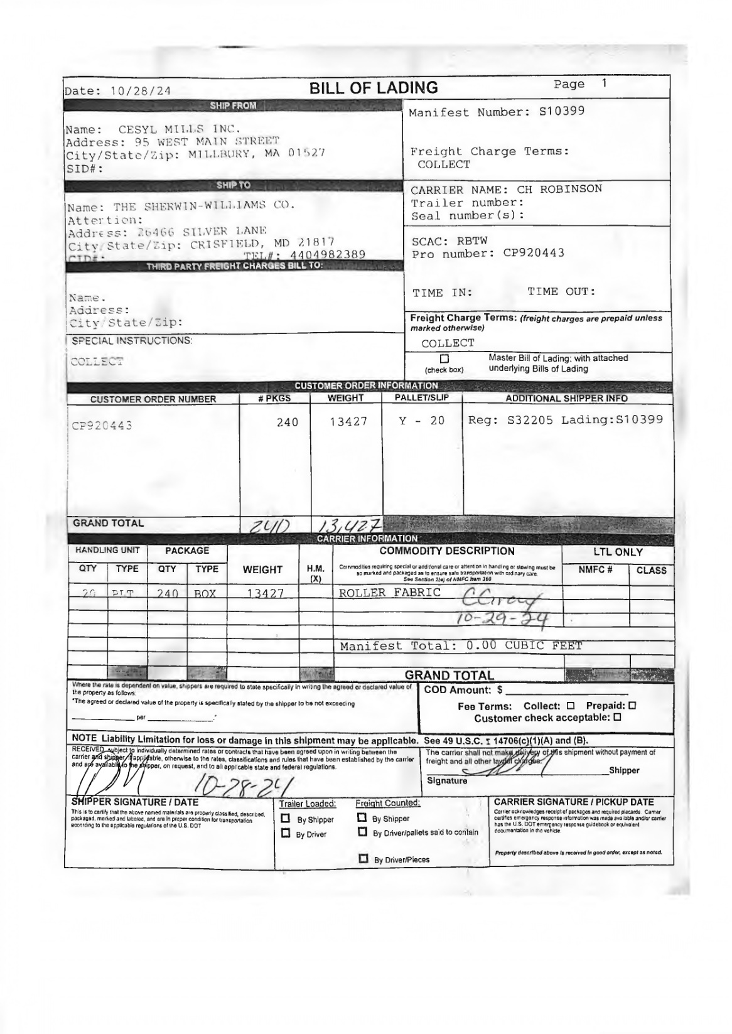
61
28
36
61 PICK UP
28 SHIPPER BOL
31 CONSIGNEE BOL
36 FREIGHT TERM
68a ORD
95 PCSCNT
96/97 GROSS/NET WT
31
68a
95
96/97

Slide 6
For Verification Table
 | NAME | DATE
DI-61163 | JOYCE MAE CATUBIG | 07/04/2024
DI-63297 – Updated according to instruction (slide 2 ) | KHEILA MARY INOC | 08/27/2024
DI-63359 - Updated according to instruction (slide 2 ) | KHEILA MARY INOC | 08/28/2024
DI-65874 – Added new invoice format (slide 4&5) | Cidjane J. Locaylocay | 11/13/2024

